Slide 1
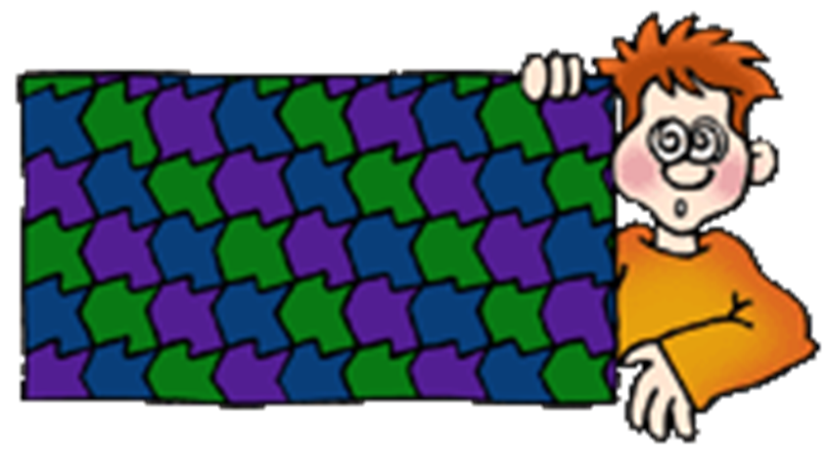
Tessellation Grade 7
Saranga wasanthi Wijayawardana
DEEMIT/II/0008

Slide 2
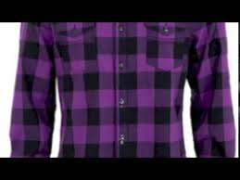
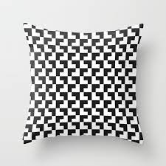
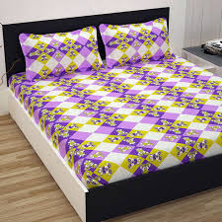
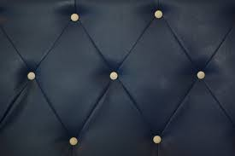
Tessellation works

Slide 3
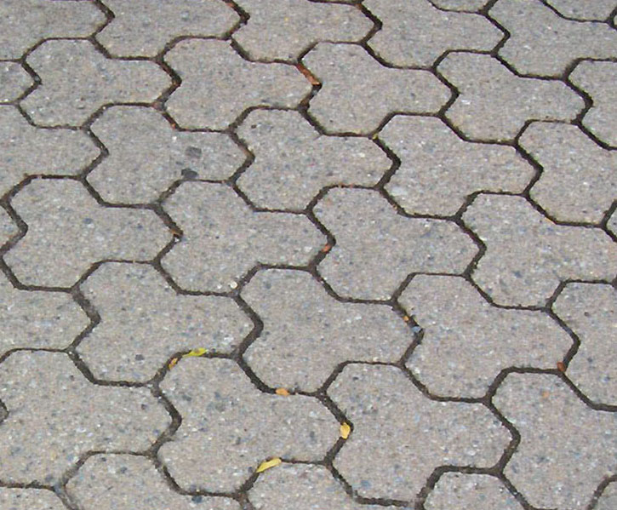
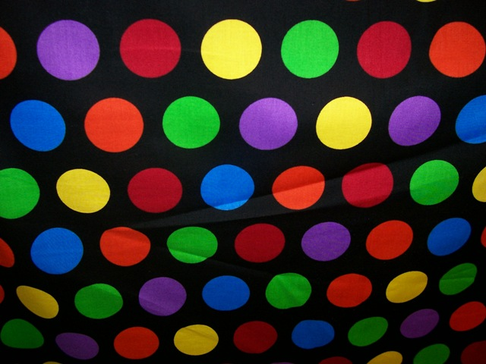
What is a Tessellation?
The process of creating a design consisting of the repeated use of one or more shapes, closely fitted together without any gaps or overlaps, on a plane.

Slide 4
Is this a Tessellation ?
yes

Slide 5
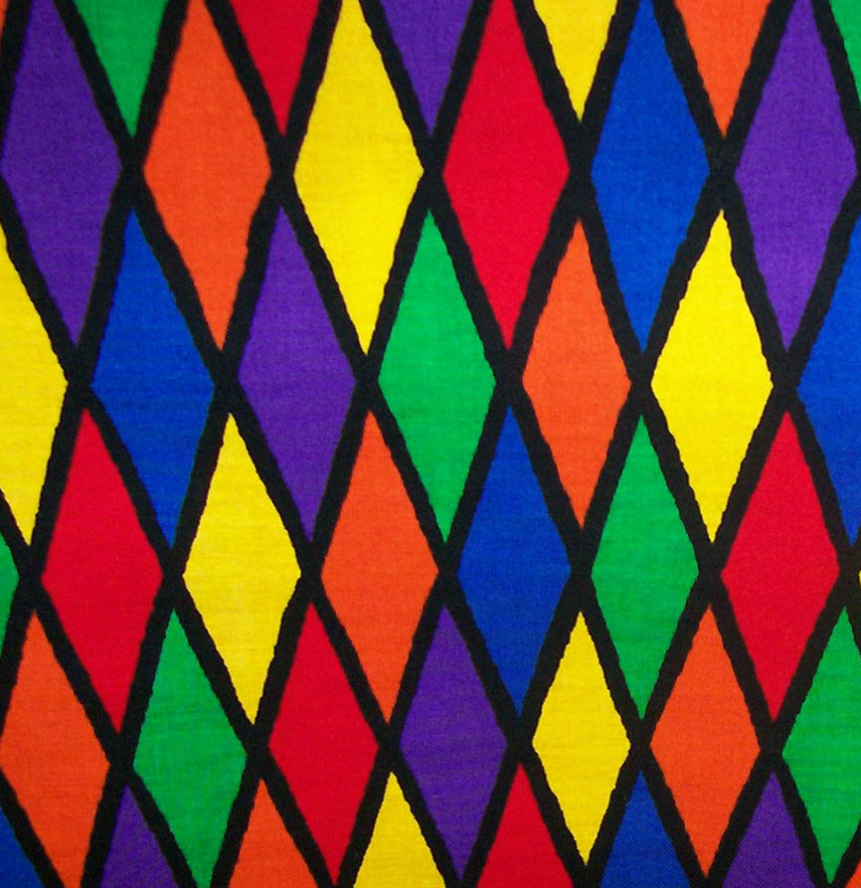
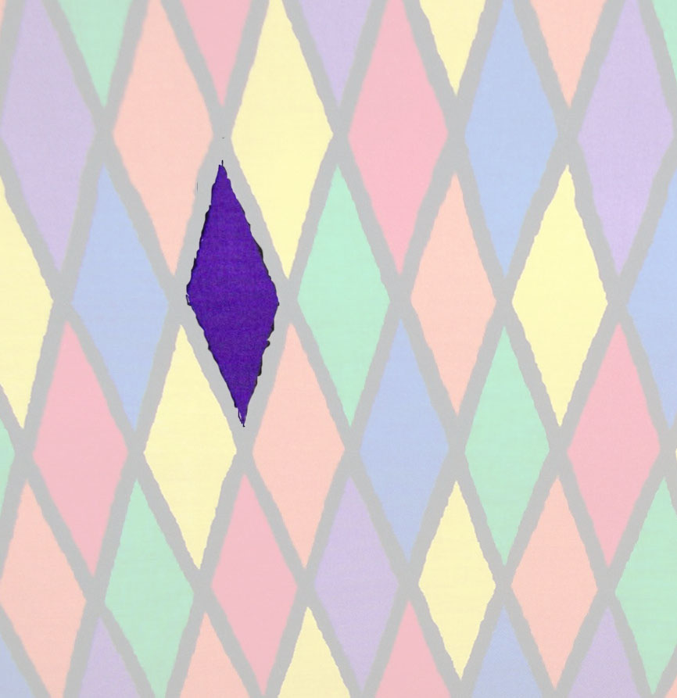
What is the shape used in this tessellation ?
Rhombus

Slide 6
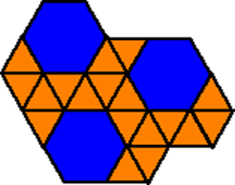
Pure Tessellation : A tessellation that uses only ONE shape
Semi-pure Tessellations : Tessellations that involve more than one type of shape are called semi-pure tessellations.

Slide 7
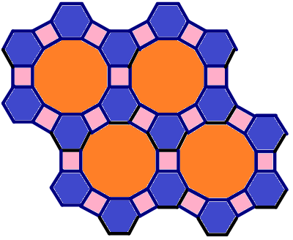
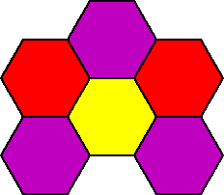
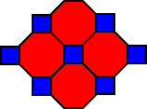
pure tessellation
semi pure tessellation

Slide 8
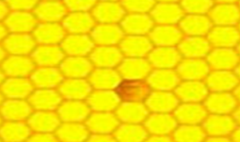
We can find tessellations in every day life

Slide 10
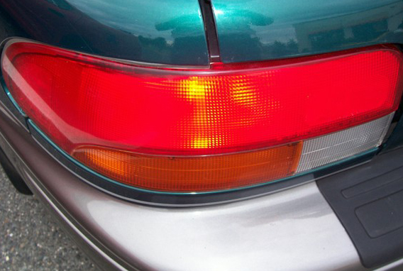
Here we have a rectangle

Slide 11
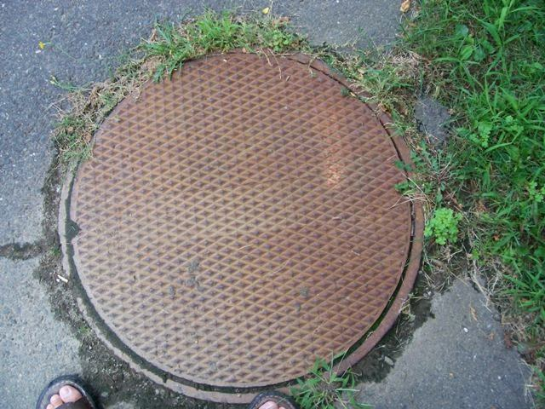
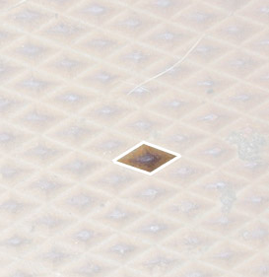
A rhombus that tessellates

Slide 12
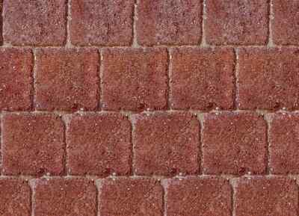
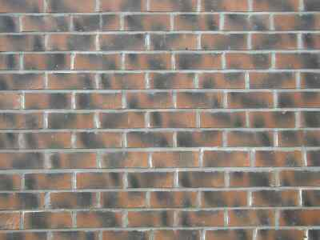
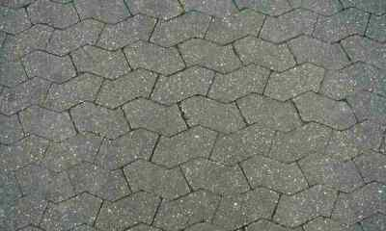
Tessellations all around us
Look for tessellations in walls and pavements.

Slide 13
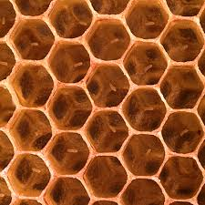
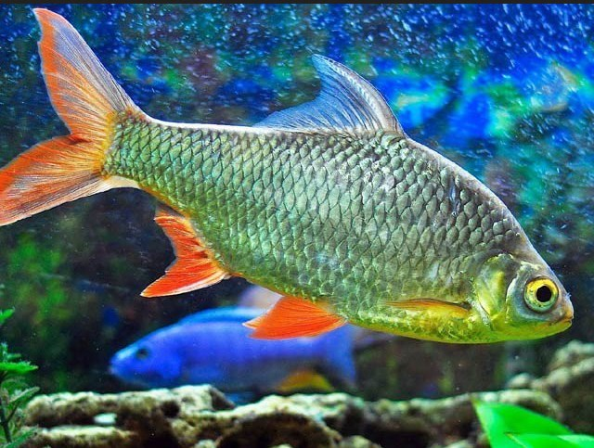
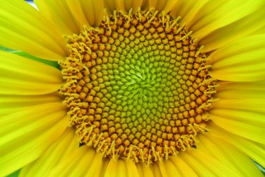
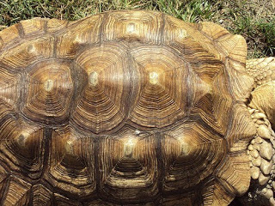
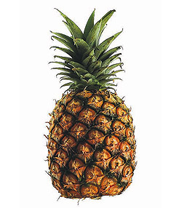
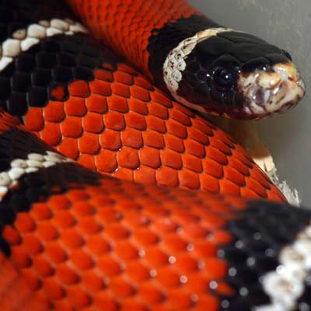
Tessellation in nature

Slide 14
Practice
Create a tessellation using squres and triangles for a fabric.
What is the type of above tessellation ?

Slide 15
Thank you !

